Slide 1
Deep Learning
Week 5

Slide 2
Artificial Neural networks motivation
Inspired by the human brain, a neural network consists of highly connected networks of neurons that relate the inputs to the desired outputs.
It learns from experiences (training instances)
The network is trained by iteratively modifying the strengths of the connections so that given inputs map to the correct response.
Best use cases:
For modeling a highly nonlinear system
When the model is supposed to get constantly updated
When the model interpretability is not a key concern.
Input
Feature extractor
Feature
ML algorithm
Output
Input
Neural networks an deep learning
Output

Slide 3
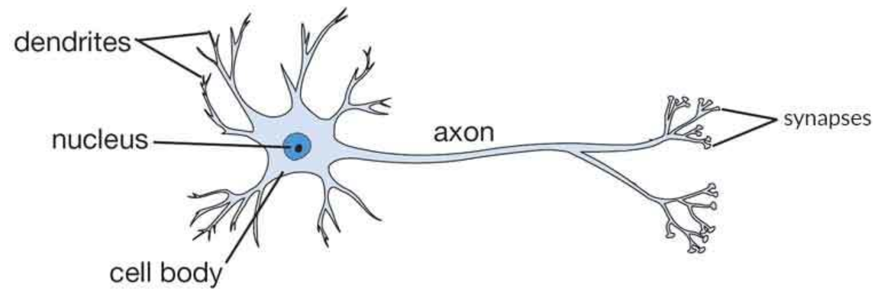
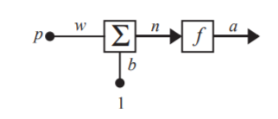
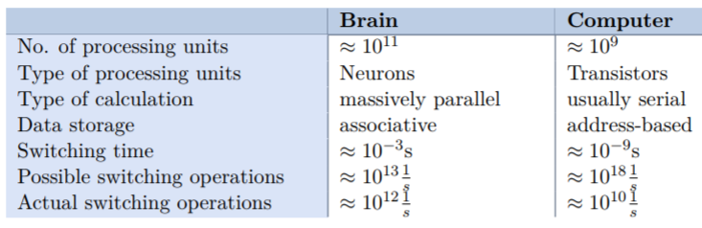
Neuron
The brain consists of a large number (approximately 10¹¹) of highly connected elements (approximately 10⁴ connections per element) called neurons.
Each neuron receives input from
many other neurons,
changes its internal state (activation)
based on the current input,
sends one output signal to many other
neurons

Slide 4
Neuron
Weight (w): is coefficient that scale (amplify or minimize) the input signal to a given neuron in the network.
Bias (b): is scalar value added to the input to ensure that at least a few nodes per layer are activated regardless of signal strength
Activation function (f): The function that govern the artificial neuron’s behavior.
Activation: When an artificial neuron passes on a nonzero value to another artificial neuron.

Slide 5
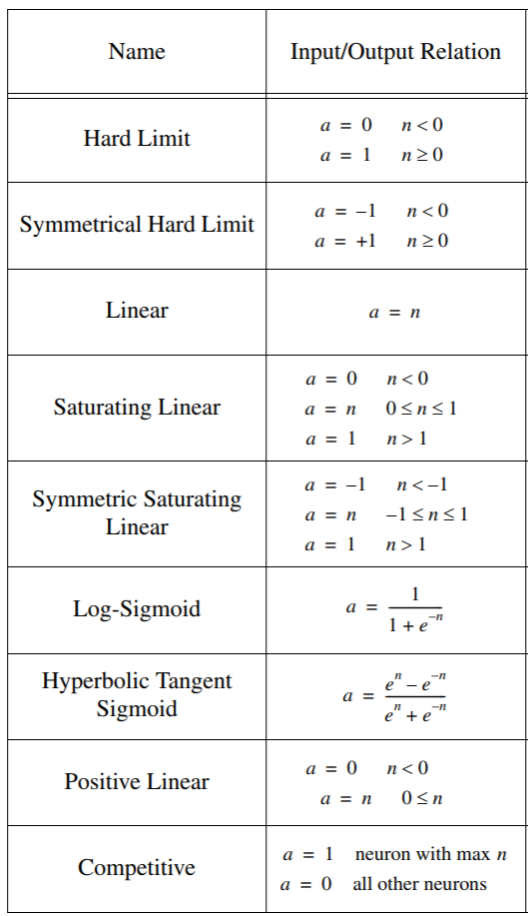
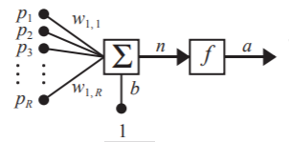
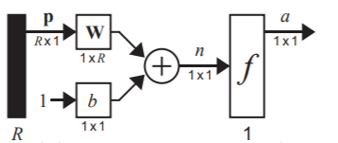
What is perceptron?
Multiple-Input Neuron
n= w_{1,1}p₁+w_{1,2}p₂+…+w_{1,R}p_{R}
w₁
 | W₁ | W₂ | b
& | 1 | 1 | -1.5
OR | 1 | 1 | 0.5
NOT | -1 | 0 | 0.5
w₂
b

Slide 6
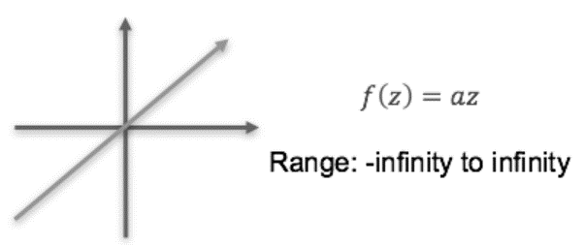
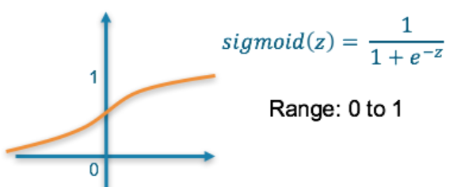
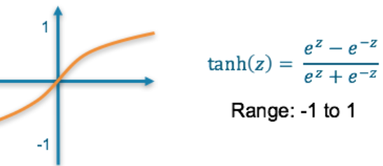
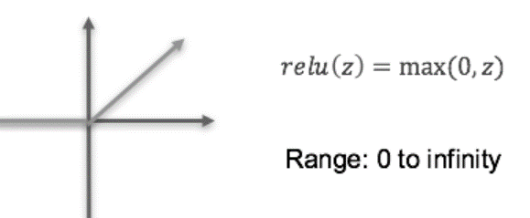
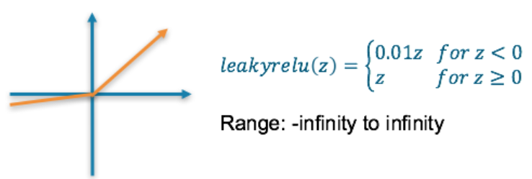
Activation function
Linear Activation Function Sigmoid, tanh Activation Function
Doesn’t capture complex patterns Bounded, capture more complex patterns ,
Can suffer from “vanishing gradient”
Rectified Linear Unit (ReLU) Leaky ReLU Activation Function
Capture more complex patterns, Values can get very large, not allow for negative values,

Slide 7
Activation function
A neural network without an activation function is essentially just a linear regression model.
Sigmoid functions ➔ case of classifiers
Sigmoid and tanh functions are sometimes avoided due to the vanishing gradient problem
ReLU function is a general activation function and is used in most cases these days
If we encounter a case of dead neurons in our networks the leaky ReLU function is the best choice
Always keep in mind that ReLU function should only be used in the hidden layers
As a rule of thumb, you can begin with using ReLU function and then move over to other activation functions in case ReLU doesn’t provide with optimum results

Slide 8
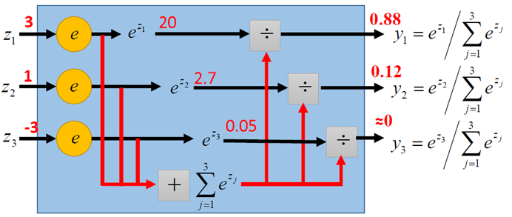
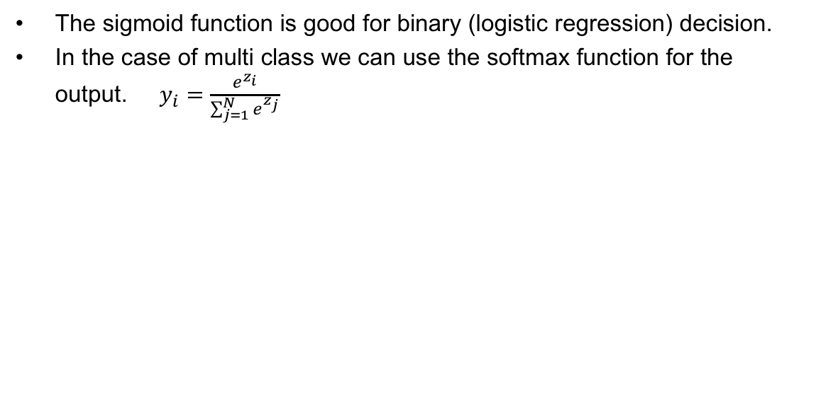
Activation function: Softmax
The sigmoid function is good for binary (logistic regression) decision.
In the case of multi class we can use the softmax function for the output. $y_{i}=\frac{e^{z_{i}}}{\sum_{j=1}^{N}{e^{z_{j}}}}$

Slide 9
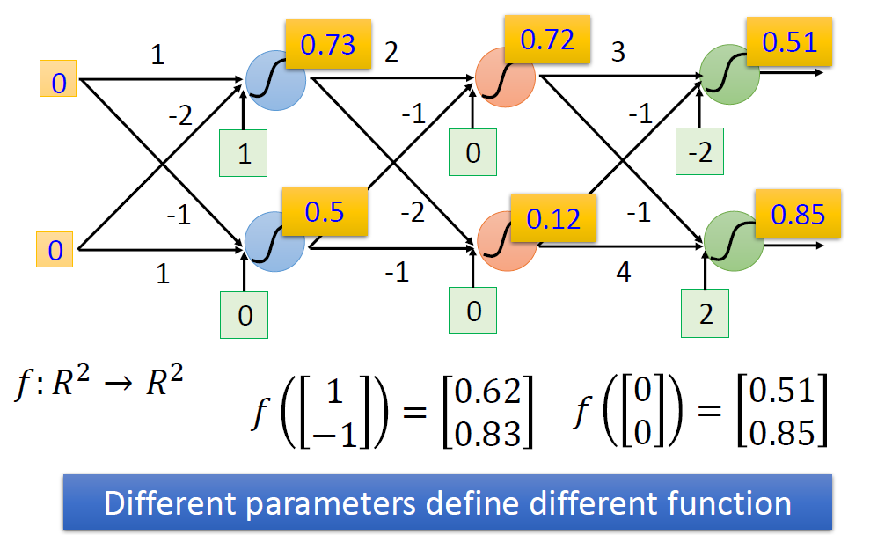
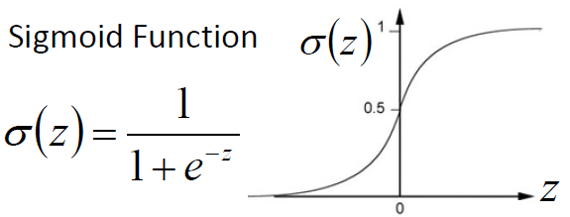
Example of Neural Network

Slide 10
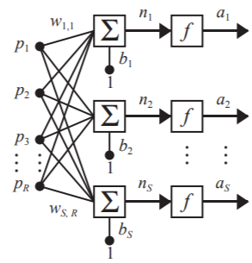
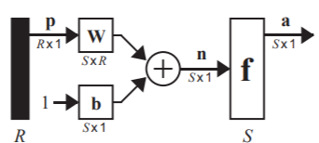
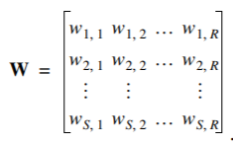
A Layer of Neurons
The network of S-neuron, R-input, one-layer network

Slide 11
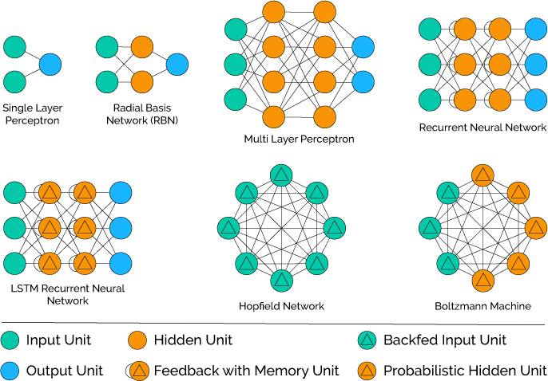
Neural Network Architecture Types

Slide 12
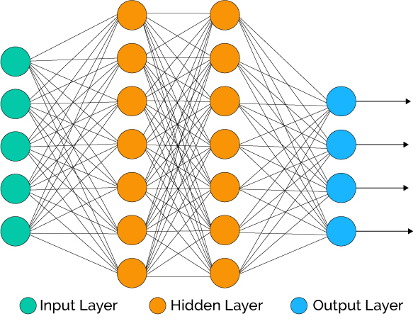
Feed-forward neural networks
A single input layer, One or many hidden layers, fully connected and a single output layer
Connection only to the next layer
The weights of the connections (between two layers) can be changed

Slide 13
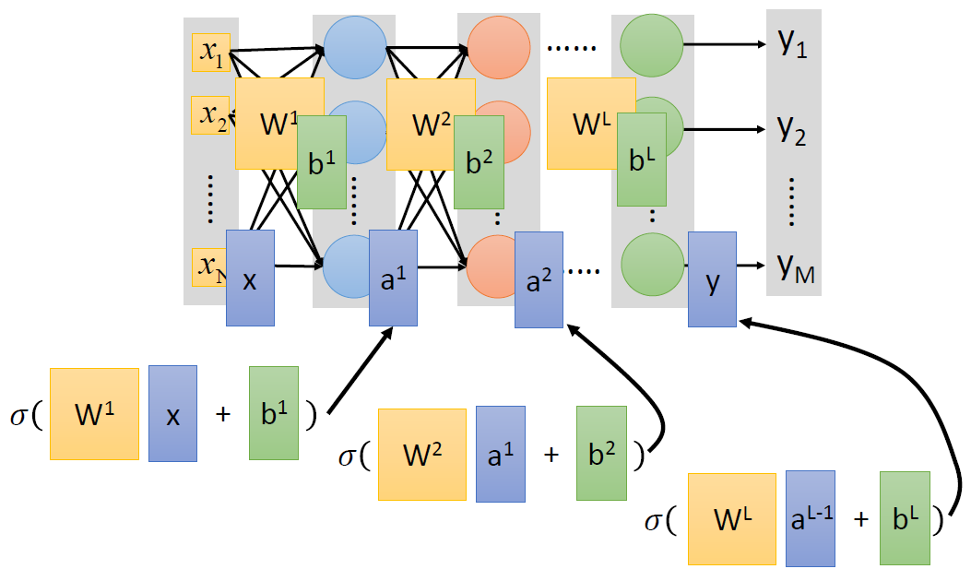
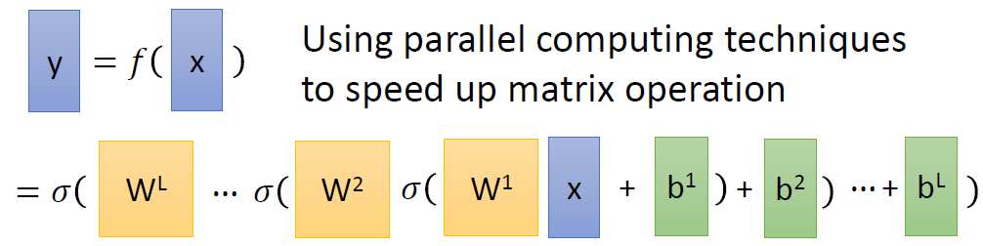
Feed Forward Neural Network Model

Slide 14
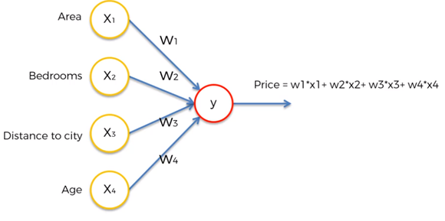
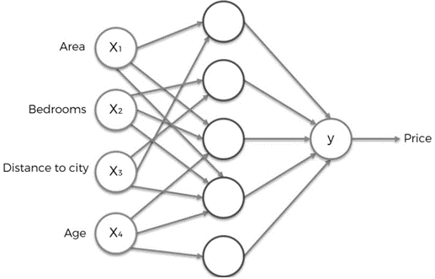
Linear vs Non-Linear Modeling

Slide 15
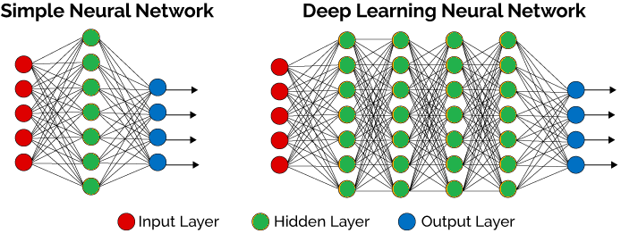
What is deep learning
Deep learning is a specific subfield of machine learning which emphasis on learning successive “layers” toward a more meaningful representations.

Slide 16
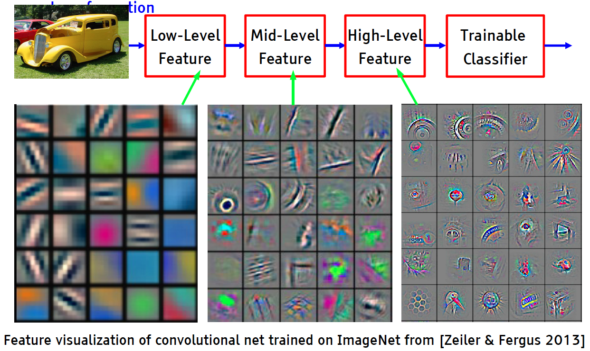
Example : image recognition

Slide 17
Terminologies
Learning
Adjust neural network weights to map inputs to outputs and minimize the error.
Error
The error value is the amount by which the value output by the network differs from the target value.
Epoch
Cycle of presentation of the entire training set to the neural network.
Cross validation
An often proposed solution for these problems is to divide, the training set into
training set really used to train ,
verification set to test the progress

Slide 18
Terminologies
Questions:
Quantity and form of input data
How must the weights be modified to allow fast and reliable learning?
Success measure ?
Number of iterations (Epochs)
Stability?
Learning time?
Order of pattern representation?
When do we stop learning?
…
Entering training data (neuron activations)
Forward propagation
Output assessment and error calculation
Correction of the network is calculated
(Back-propagate)
Apply the collection
Error < threshold ?

Slide 19
Supervised learning rules
The objective of learning rules is to tune the weights and bias of neurons in the neural network using the labeled data in an iterative way.
Hebbian rule (1949)
It identifies, how to modify the weights of neurons of a network.
http://penta.ufrgs.br/edu/telelab/3/hebbian_.htm
Perceptron rule
Network starts its learning by assigning a random value to each weight.
http://hagan.okstate.edu/4_Perceptron.pdf
Delta rule
Gradient descent learning rule for updating the weights
https://en.wikipedia.org/wiki/Delta_rule
Outstar rule
We can use it when it assumes that neurons arranged in a layer.

Slide 20
Loss function
Loss functions quantify the agreement between the predicted output (or label) and the ground truth output. We use loss functions to determine the penalty for an incorrect classification of an input vector
Actual output for a given input comparing to correct output.
Objective I to minimize the loss by improving the model prediction
This lead to correctly choose the weights and the biases of each neuron in the network.
Gradient descent is an optimisation algorithm to iterate on the different weights toward the best weights for minimizing the loss.

Slide 21
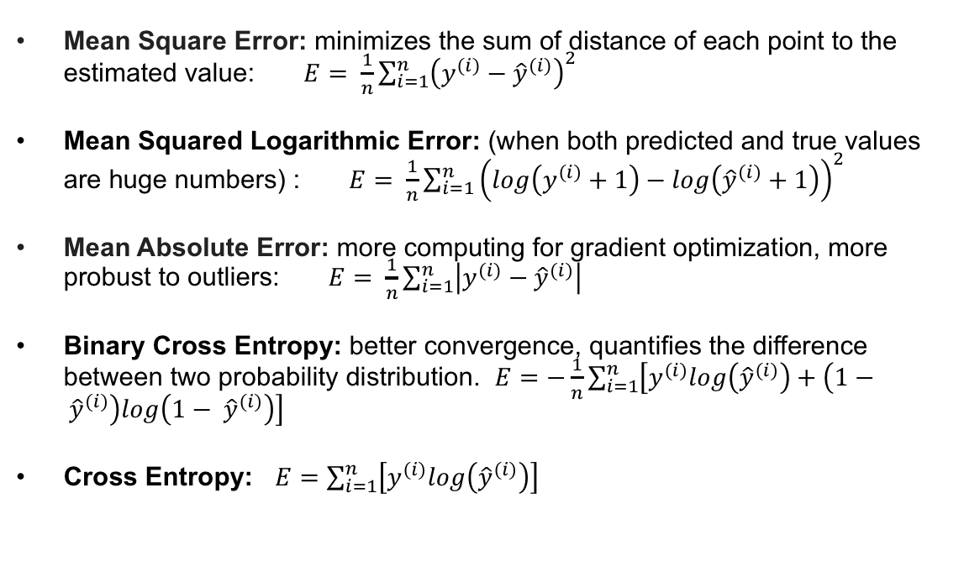
Loss function (energy function)
Mean Square Error: minimizes the sum of distance of each point to the estimated value: $E= \frac{1}{n}\sum_{i=1}^{n}{{\left(y^{(i)}−{\hat{y}}^{(i)}\right)}^{2}}$
Mean Squared Logarithmic Error: (when both predicted and true values are huge numbers) : $E= \frac{1}{n}\sum_{i=1}^{n}{{\left(log\left(y^{(i)}+1\right)−log\left({\hat{y}}^{(i)}+1\right)\right)}^{2}}$
Mean Absolute Error: more computing for gradient optimization, more probust to outliers: $E= \frac{1}{n}\sum_{i=1}^{n}{\left|y^{(i)}−{\hat{y}}^{(i)}\right|}$
Binary Cross Entropy: better convergence, quantifies the difference between two probability distribution. $E=−\frac{1}{n}\sum_{i=1}^{n}{\left[y^{(i)}log\left({\hat{y}}^{(i)}\right)+\left(1− {\hat{y}}^{(i)}\right)log\left(1− {\hat{y}}^{(i)}\right)\right]}$
Cross Entropy: $E=\sum_{i=1}^{n}{\left[y^{(i)}log\left({\hat{y}}^{(i)}\right)\right]}$

Slide 22
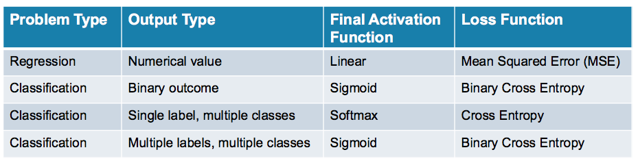
What loss function to use?
Categorical cross entropy: one-hot encoded targets [1 0 0 ],
Sparse categorical cross entropy: Integers targets[2 3 4]

Slide 23
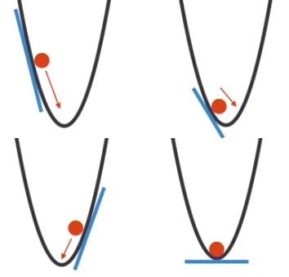
Optimizers
Gradient Descent-
Stochastic gradient descent
Mini Batch Gradient Descent
Optimizing the Gradient Descent-
Momentum
Nesterov accelerated gradient
Adagrad
RMSProp
Adam
https://hackernoon.com/demystifying-different-variants-of-gradient-descent-optimization-algorithm-19ae9ba2e9bc
Adam works well in practice and outperforms other Adaptive techniques.

Slide 24
Training Basics
The most basic method of training a neural network is trial and error.
If the network isn't behaving the way it should, change the weighting of a random link by a random amount. If the accuracy of the network declines, undo the change and make a different one.
It takes time, but the trial and error method does produce results.
Sample labeled data
(batch)
Forward it through the network, get predictions
Back-propagate the errors
Update the network weights

Slide 25
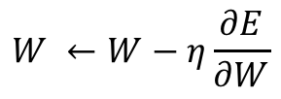
Training Basics
Searches for weight values that minimize the total error of the network over the set of training examples (training set).
Process:
Forward pass: in this step the network is activated on one example and the error of (each neuron of) the output layer is computed.
Backward pass: in this step the network error is used for updating the weights. Starting at the output layer, the error is propagated backwards through the network, layer by layer. This is done by recursively computing the local gradient of each neuron.
Network activation
Forward Step
$$W ←W−η\frac{∂E}{∂W}$$
Error propagation
Backward Step

Slide 26
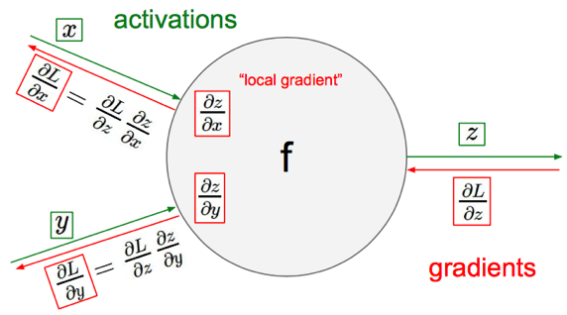
Gradient Descent

Slide 27
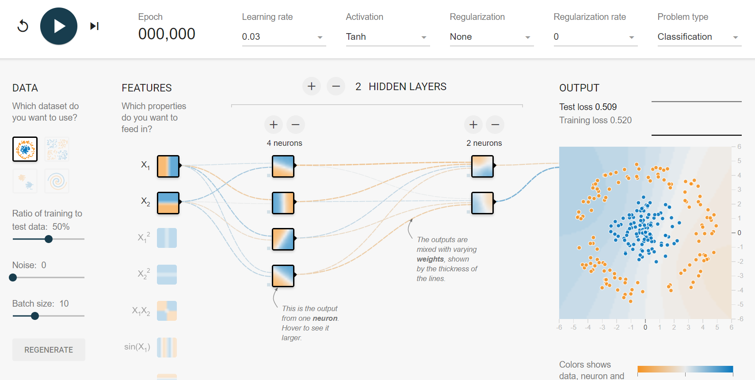
Demo
https://playground.tensorflow.org/

Slide 28
Keras : Deep neural network library
Keras is a high-level neural networks API, written in Python and capable of running on top of TensorFlow, CNTK, or Theano. It was developed with a focus on enabling fast experimentation. Being able to go from idea to result with the least possible delay is key to doing good research.
Use Keras if you need a deep learning library that:
Allows for easy and fast prototyping (through user friendliness, modularity, and extensibility).
Supports both convolutional networks and recurrent networks, as well as combinations of the two.
Runs seamlessly on CPU and GPU.
Read the documentation at Keras.io.

Slide 29
Keras workflow
Prepare input data (Image, video, text, column data, ..)
Define the neural network architecture (sequential/functional)
Select the optimizer
Select the loss function
Select the appropriate evaluation metric for the given problem
Train and evaluate

Slide 30
Model type
Sequential:
models are linear stack of layers
Treat each layer as object that feed into the next.
Graph
Optimized over all outputs
Graph model allows for two or more independent networks to diverge or merge
Allows for multiple separate inputs/outputs
Different merging layers

Slide 31
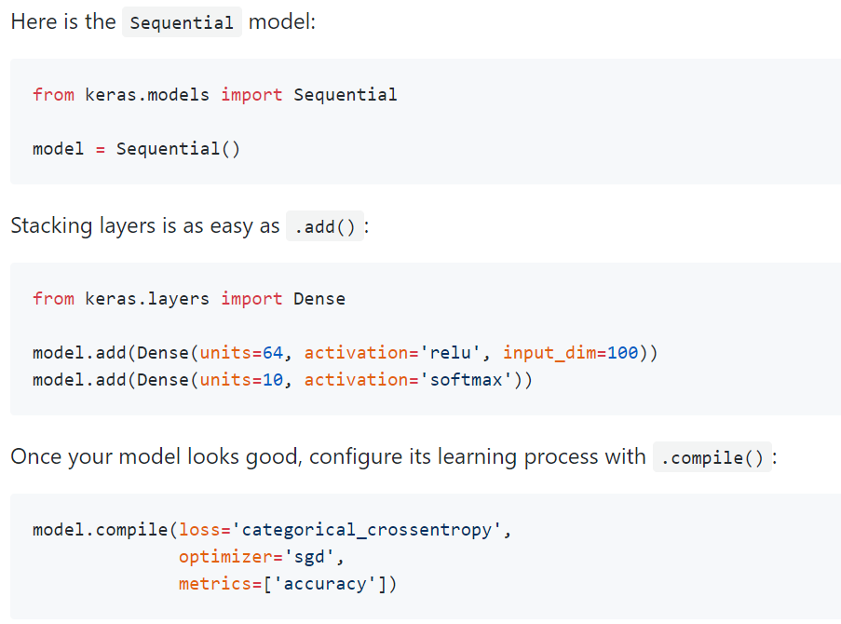
Sequential class

Slide 32
Hyper parameters
Type of activation function
Learning rate
How many neurons in each layer
How many hidden layers do we need?
How many training sample do I need?
What the batch size should be?

Slide 33
Hyper parameters
Number of layers:
0 hidden layer: Only capable of representing linear separable functions or decisions.
1 hidden layer: Can approximate any function that contains a continuous mapping from one finite space to another.
2 hidden layer: Can represent an arbitrary decision boundary to arbitrary accuracy with rational activation functions and can approximate any smooth mapping to any accuracy.
>2 hidden layer: Additional layers can learn complex representations (sort of automatic feature engineering) for layers.

Slide 34
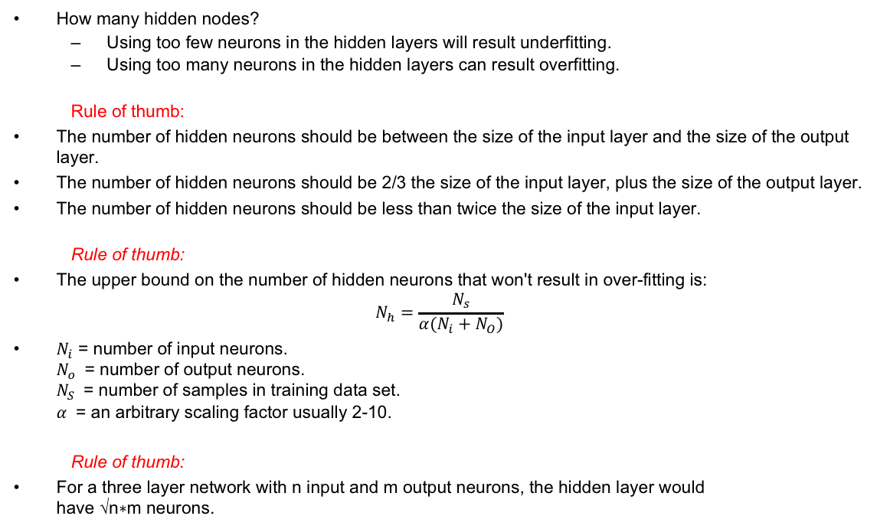
Hyper parameters
How many hidden nodes?
Using too few neurons in the hidden layers will result underfitting.
Using too many neurons in the hidden layers can result overfitting.
Rule of thumb:
The number of hidden neurons should be between the size of the input layer and the size of the output layer.
The number of hidden neurons should be 2/3 the size of the input layer, plus the size of the output layer.
The number of hidden neurons should be less than twice the size of the input layer.
Rule of thumb:
The upper bound on the number of hidden neurons that won't result in over-fitting is:
$$N_{h}=\frac{N_{s}}{α(N_{i}+N_{O})}$$
$N_{i}$ = number of input neurons. $N_{o}$ = number of output neurons. $N_{S}$ = number of samples in training data set. $α$ = an arbitrary scaling factor usually 2-10.
Rule of thumb:
For a three layer network with n input and m output neurons, the hidden layer would have √n∗m neurons.

Slide 35
Hyper parameters
Optimal batch size:
A smaller mini-batch size (not too small) usually leads not only to a smaller number of iterations of a training algorithm, than a large batch size, but also to a higher accuracy overall,
Too small mini-batch might get too slow because of significantly lower computational speed, because of not exploiting vectorization to the full extent. In this case the gradient of that sample may take you completely the wrong direction.
Rule of thumb:
usually 32--512 data points,

Slide 36
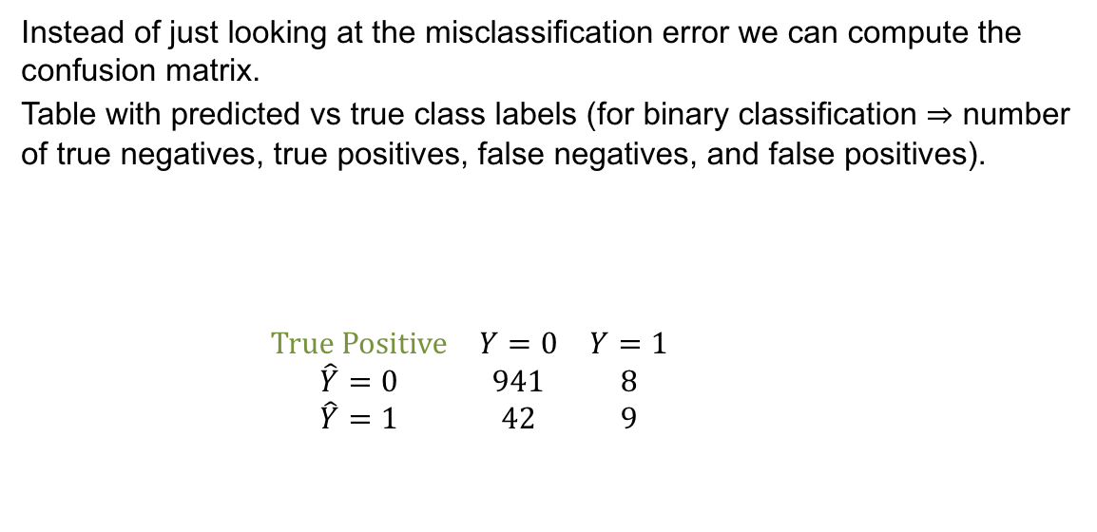
Confusion matrix
Instead of just looking at the misclassification error we can compute the confusion matrix.
Table with predicted vs true class labels (for binary classification ⇒ number of true negatives, true positives, false negatives, and false positives).
$\begin{matrix}True Positive & Y=0 & Y=1 \\ \hat{Y}=0 & 941 & 8 \\ \hat{Y}=1 & 42 & 9\end{matrix}$
Realized
False positive
Prediction
False negative
True Negative

Slide 37
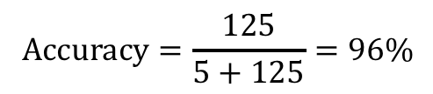
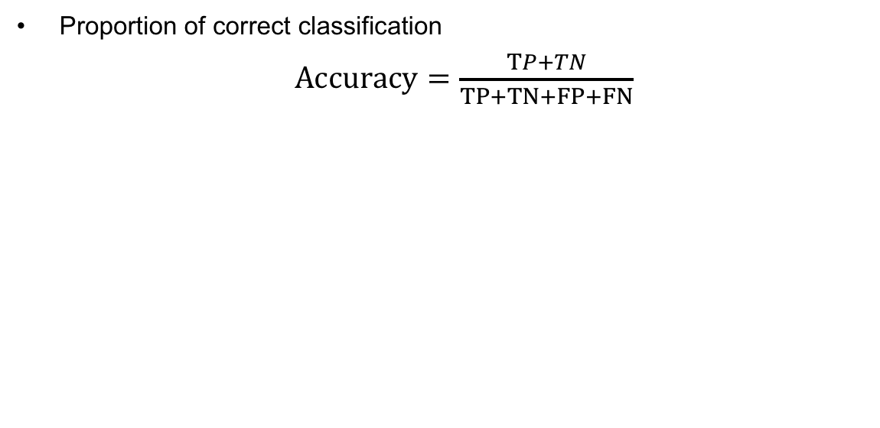
Key matrix
Proportion of correct classification
$Accuracy=\frac{TP+TN}{TP+TN+FP+FN}$
 | Real + | Real -
Predict + | 0 | 0
Predict - | 5 | 125
$$Accuracy=\frac{125}{5+125}=96\%$$

Slide 38
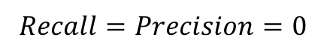
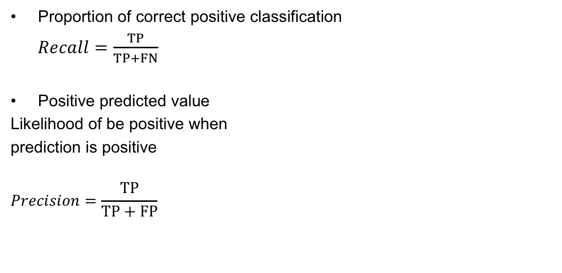
Key matrix
Proportion of correct positive classification
$Recall=\frac{TP}{TP+FN}$
Positive predicted value
Likelihood of be positive when
prediction is positive
$$Precision=\frac{TP}{TP+FP}$$
 | Real + | Real -
Predict + | TP | FP
Predict - | FN | TN
 | Real + | Real -
Predict + | 0 | 0
Predict - | 5 | 125
$$Recall=Precision=0$$

Slide 39
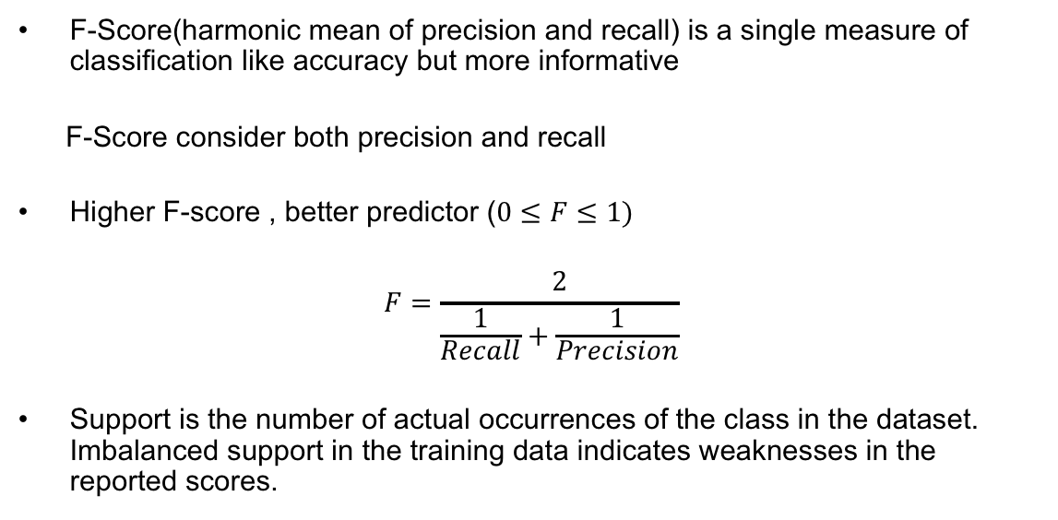
F-score/Support
F-Score(harmonic mean of precision and recall) is a single measure of classification like accuracy but more informative
F-Score consider both precision and recall
Higher F-score , better predictor ($0≤F≤1)$
$$F=\frac{2}{\frac{1}{Recall}+\frac{1}{Precision}}$$
Support is the number of actual occurrences of the class in the dataset. Imbalanced support in the training data indicates weaknesses in the reported scores.

Slide 40
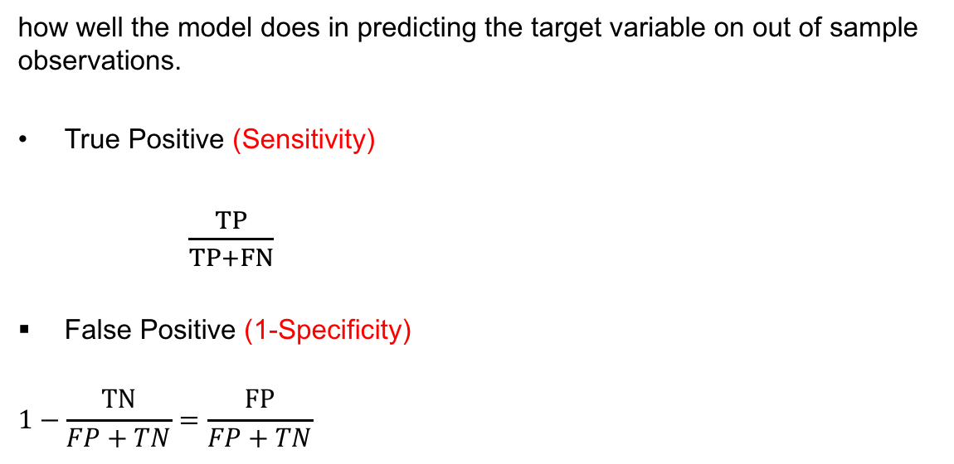
Contingency tables
how well the model does in predicting the target variable on out of sample observations.
True Positive (Sensitivity)
$\frac{TP}{TP+FN}$
False Positive (1-Specificity)
$$1−\frac{TN}{FP+TN}=\frac{FP}{FP+TN}$$
 | Real + | Real -
Predict + | TP | FP
Predict - | FN | TN

